Slide 1
Lecture 12 – System Interfaces

Slide 2
Outline
Types of System Interfaces
  Power
  Data
  Heat and Mass transfer
  Mechanical
N2N Diagrams
Interface Documentation
Subtle interfaces
Interface management techniques
Quick Disconnects
Electrical Connectors
Digital Interfaces
Human-System Interfaces – one of the most important - will be discussed in a whole other lecture

Slide 3
Types of System Interfaces and Critical Characteristics
Power
  Electrical – at least two wires – power and return – specified in terms of voltage, current (frequency and phase for Alternating Current (AC) systems), connector type, pinout, wire gage
  Hydraulic – a supply and return line – pressure, flow rate, diameter, fitting
  Pneumatic – a supply line and perhaps a vent – pressure and flow, diameter, fitting
Data/Information for sensing and control
  Electrical – signal and reference – individual conductors, twisted pair, shielded twisted pair, coaxial cable – standards on signal levels
  Optical – single to multiple fibers
Heat transfer to maintain operating environments
  In commercial devices often rely on convection – the motion of heat from an object by heat transfer to air molecules which then move away from an object because hot air rises
  In higher power devices or those which operate at altitude or in space we accomplish heat transfer through a heating or cooling fluid flowing through a “cold plate”. Devices usually have a conduction path to the cold plate
  Can’t rely on convection at high altitude or in zero g because convection relies both on density of molecules and gravity
Mass transfer – fitting interface, mass flow rate, cross section, pressure, temperature
Structural
  Bolt hole patterns
  Static and dynamic
Notes:
The purpose of this chart is to show that there are four or five types of interfaces that may be accomplished by different technologies and that there are specific characteristics for each type of interface, For example you can deliver power to a device by electrical power, by hydraiulic (fluid flow) or pneumatic power (gas flow). Each of these interfaces has unique characteristics.

Slide 4
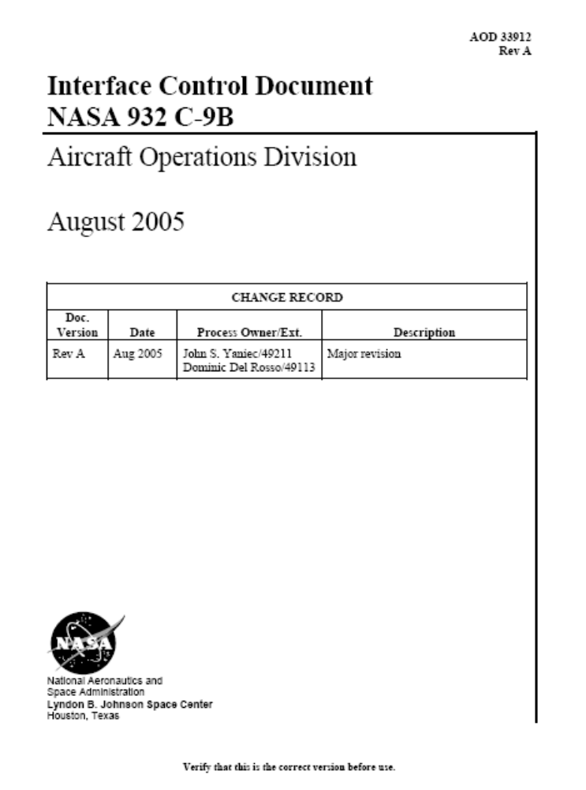
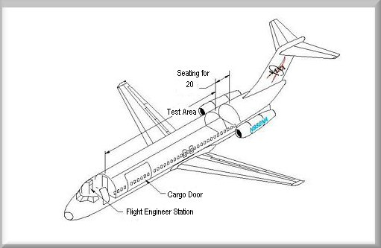

http://jsc-aircraft-ops.jsc.nasa.gov/Reduced_Gravity/guides.htm
l
Notes:
This is the cover for the Interface Control Document (ICD) between experiments and NASA’s C-9 microgravity research aircraft. This aircraft, based at Ellington Field in Houston Texas, flies parabolas over the Gulf of Mexico to generate 25 seconds of weightlessness at a time. Dubbed the “Vomit Comet” because of the wildness of the ride and its sometime effects on researchers, it is one of NASA’s major tools for performing earth based microgravity research for developing instruments for spaceflight. This ICD is used as an example to show how different kinds of interfaces can be documented in an ICD. This ICD can be download from http://jsc-aircraft-ops.jsc.nasa.gov/Reduced_Gravity/guides.html

Slide 5
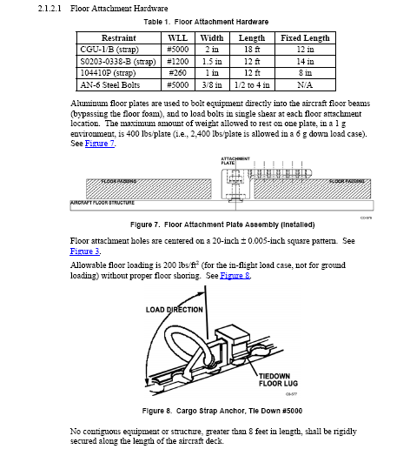
Notes:
This diagram from the ICD shows how items can be attached to the floor of the aircraft, There are two major ways to attach, either by bolts that go into predrilled floor plates or by straps that attach to lugs that bolt into predrilled holes. You will note that the limit load, or capacity of these attachments is shown,

Slide 6
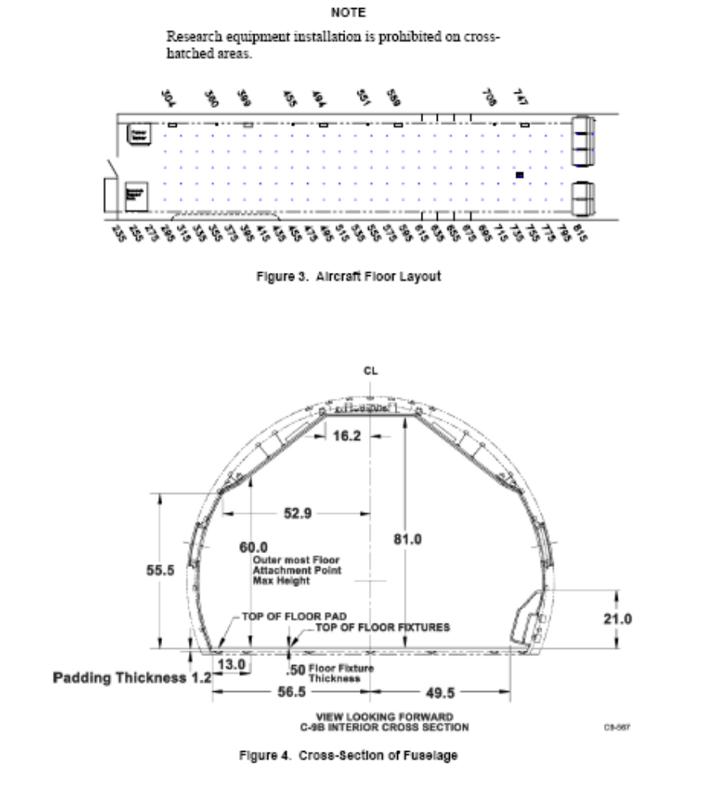
Bolt pattern
Notes:
The upper diagram describes the bolt hole pattern for attaching to the aircraft floor. Note this is special equipment on this aircraft. Most commercial aircraft attach seats to rails om the aircraft floor. This plate installed on the floor allows a wide variety of experiments to be mounted to the aircraft floor. The second diagram shows the cross section of the aircraft and the allowable envelope for scientific payloads.

Slide 7
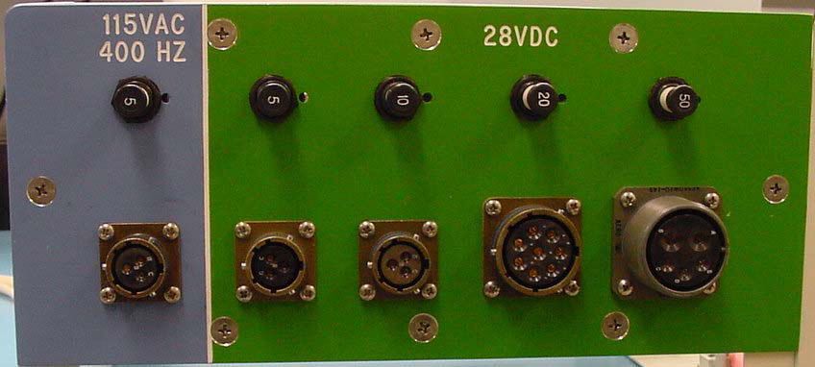
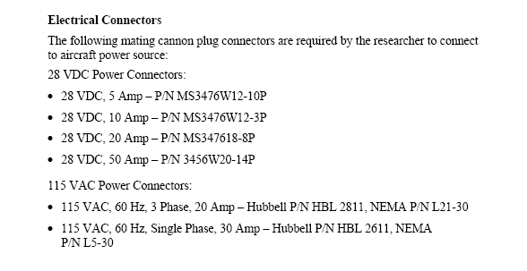
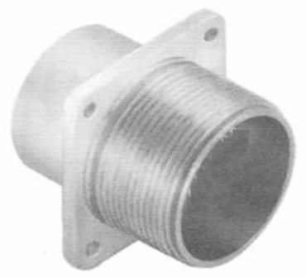
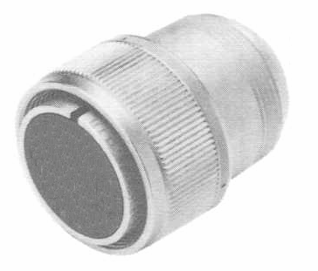
NASA Reduced Gravity Aircraft (C-9B) Electrical Panel
Notes:
This shows the electrical panel for powering scientific experiments on the aircraft along with the icd section that describes the panel./ Note interfaces are specified in terms of voltage and current capability.

Slide 8
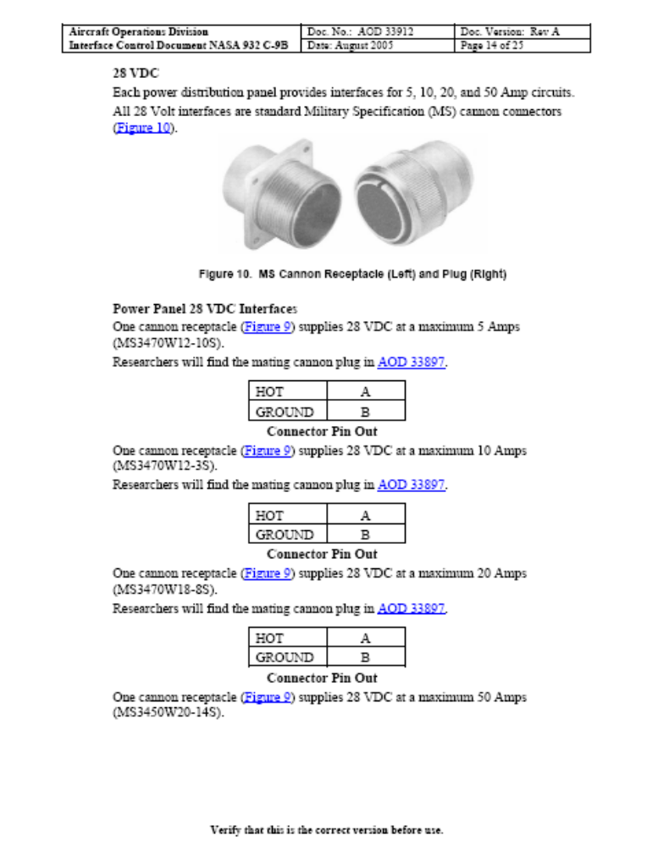
Notes:
This is more detail about the electrical interface. Note that it describes the pinout, which is the assignment of power and signal functions to pins and sockets in the connectors.

Slide 9
N2 or N2N Diagrams
Purpose of the N2N diagram is to show where there are interfaces between subsystems
N2N diagrams serve two useful purposes
  Generating them forces questions to be asked that illuminate hidden issues
  Checking designs against them identifies lost or orphaned requirements

Slide 10
Example N2 for Commercial Jetliner
 | Str | Flt Con | Hyd | Prop | Elec | ECS | Av | D&C | Mech
Structure | X | Surfaces | Line Mounts | Engine Mounts | Grounding | Mounts | Mounts | Mounts | Lgear
Flight Controls |  | X | Pwr |  | Pwr |  | Control Input | Display
Hydraulics |  |  | X | Pwr | Control | Cooling | Control | Display | Lgear
Propulsion |  |  |  | X | Pwr | Pwr | Control | Display
Electrical |  |  |  |  | X | Pwr | Pwr | Pwr | Pwr
Environmental Controls |  |  |  |  |  | X | Cooling/Press | Cooling/Press
Avionics |  |  |  |  |  |  | X | Human I/O | Cntrol
Displays and Controls |  |  |  |  |  |  |  | X | Display
Mech |  |  |  |  |  |  |  |  | X
Notes:
This example N2N diagram shows the systems of a typical commercial jetliner and the interfaces between them. For example not all systems have direct interfaces, but some ssytems, such as structure, interface to almost all systems. This diagram identifies the type of interface as well as the interface. For example, the interface between flight controls and the structure is the places where the flight control surfaces (elevators, ailerons, rudder and flaps) connect to the primary structure. The hydraulics interface to the structure in that the lines and pumps for the system have to have mountings to the structure. The propulsion systems (jet engines) also require physical mounting and this mounts have to carry the thrust loads from these powerplants along with secondary loads such as the gyroscopic effects due to the spinning engines. A more subtle interface is the interface between the structure and the structure and the electrical system. In most metallic commercial aircraft, the structure acts as the ground return for the electrical system. So all electrical loads tie to the structure in one way or another.

Slide 11
Hints
In building these diagrams, you may have to break down systems into subsystems
  For example almost everything has a power interface
  It may be more useful to break it down to type of power
    Examples: ac versus dc power
    Voltage levels e.g. 5V, 10V, 28V
    Physical arrangement

Slide 12
Interface Documentation
Interface Requirements Document (IRD) usually state the requirements for services across interfaces
  E.g. the external tank shall supply liquid hydrogen and liquid oxygen to the orbiter
Interface Control Document (ICD) – approved document signed by both sides of the interface that controls the details of the interface
  E.g. the external tank shall supply liquid hydrogen through a 17 inch diameter disconnect
Interface Revision Notice (IRN) – the paperwork to notify everyone and gain their approval of an interface change
Drawings – actually implement the interface
Nameplates – labeling next to an interface to ensure that only proper connections are made

Slide 13
Subtle interfaces
  Bonding and grounding
  Galvanic corrosion
  Material compatibility
  Debris
  Ground Support Equipment
  Factory test or onboard test
  Maintenance or servicing
  Lifting or platform
  Transportation or shipping
  Outer moldline control

Slide 14
Interface Management Techniques
Specifying the interface is not usually enough unless an interface standard is very mature
  E.g. a 3 prong ac power plug for 20 VAC power is a mature standard
  Normally can manufacture equipment with confidence that it will mate with most wall sockets for 3 prong plugs
  Society of Automotive Engineers (SAE) (aerospace division) is the standard repository for most standards
  http://www.sae.org/technical/standards/aerospace/
In order to minimize the thrashing associated with interfaces with less mature standards, it is common to assign a single entity responsibility for both of the “mating” halves of an interface
For example, when buying an electronics assembly it is often common practice to buy the mating connectors at the same time
  Since one half of the connectors is manufactured into the electronics box, there usually isn’t much choice as to the mating connector
  The entity installing the box then “wires up” to the mating interface
  Sometimes SAE standards are mature enough to specify the mating connector

Slide 15
Interface Management Techniques
When the interface is a unique design – such as a separation interface, it is common to have the two halves designed and manufactured together
For example a launch umbilical may contain electrical connectors, mechanical alignment and attachment and fluid/gas interfaces – this requires a custom design
A carrier plate often provides the mechanical attachment, separation mechanism and the mounting for electrical and fluid connectors

Slide 16
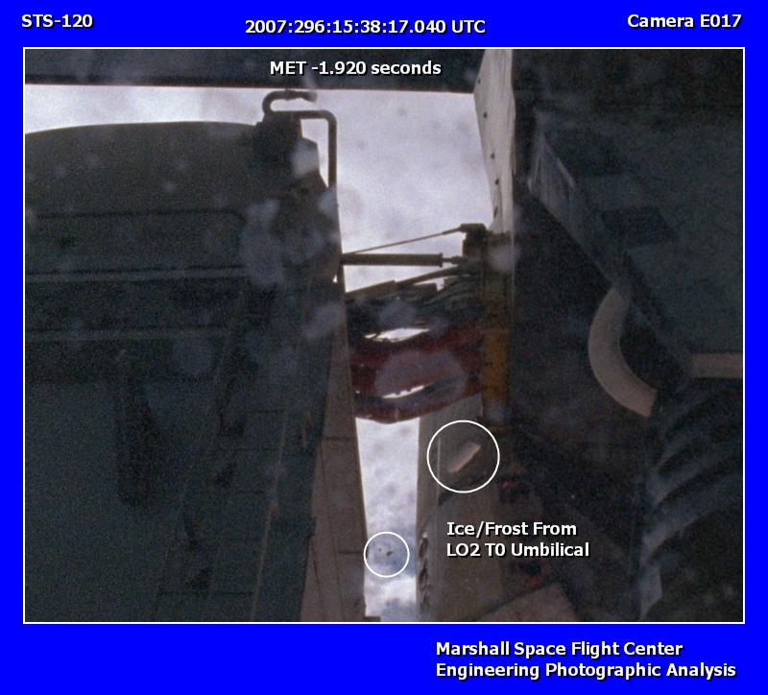
Notes:
This is a picture if the T-0 umbilical on the space shuttle. It is called T-0 because it is released when the countdown reaches zero (Time 0). There are two of these umbilicals and each of them have multiple connections for power, cooling, hydraulic fluid, gases and cryogenic propellants. The umbilicals rise through two large box like structures called the Tail Service Masts (TSMs). One TSM is seen in the left half of this picture. Because there are multiple interfaces that must be broken simultaneously, a carrier plate is used to hold all of the interface connections.

Slide 17
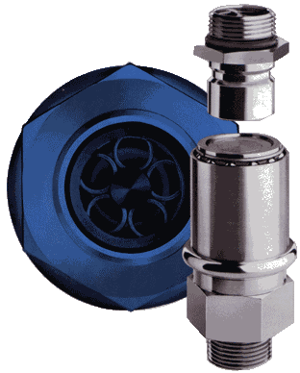
Interface Management Techniques
Fluid interfaces may be a common standard (SAE) fittings or unique connections are procured at the time of the unit purchase and then “plumbed up”
Quick Disconnect is a special type of fitting that closes as it separates
  Does not need a separate cover
  Avoids leaking fluids at disconnection
Quick Disconnects are an important consideration when
Fluids are
  Reactive
  Flammable
  Electrically conductive
  Noxious or toxic
  Volume critical
  Slippery if spilt on floors

Slide 18
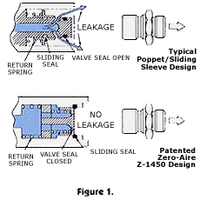
QD Action
http://www.whittakercontrols.com/products/products_qd.asp
Notes:
Here are two types of quick disconnects. Very common in aerospace design they are also used in many other types of applications. Often quick disconnects are used with garden hoses so that the hoses can be connected and disconnected without turning the water off. Buying some of this type of hardware from the local hardware store makes a good way to demonstrate this type of fitting in class. Another major safety use of quick disconnects in everyday life is at automobile gasoline filling stations. The hoses typically have a quick disconnect at the top of the hose so that if a customer drives away with a filling hose still in their gas tank, that the line to the pump will not be opened up when the line is pulled away from the filling station.

Slide 19
Electrical Connectors
Consist of
  A backshell – secures the wires and closes out the back
  Insert – provides for the orientation of the mating elements
  Mating elements – pins or sockets
    Side with pins is P side of connector, Side with sockets is J side
  Front shell – establishes the mechanical mate to the other half of the connector
Mating element
wire
backshell
Insert
Front Shell

Slide 20
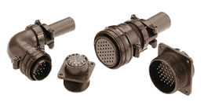
Incredible array of options in connection design
Intermatable and intermountable with Amphenol and MIL-C-5015The DMS series offers Hard dielectric interial Zinc plated die cast aluminum shells with olive drab chromate finish A selection of over 73 insert arrangements spanning 12 shell sizes and 5 contact sizes See documentation for more
Amphenol MIL-C-5015 Compatible Connectors for Less

Slide 21
Documenting connections
Point to point diagram
Highway or trunkline
Block interconnection
Notes:
There are thre emajor ways to describe an interconnect wiring plant. Thes eare common whether the wiring plant is in an aircraft, ship, car, building or industrial plant.

Slide 22
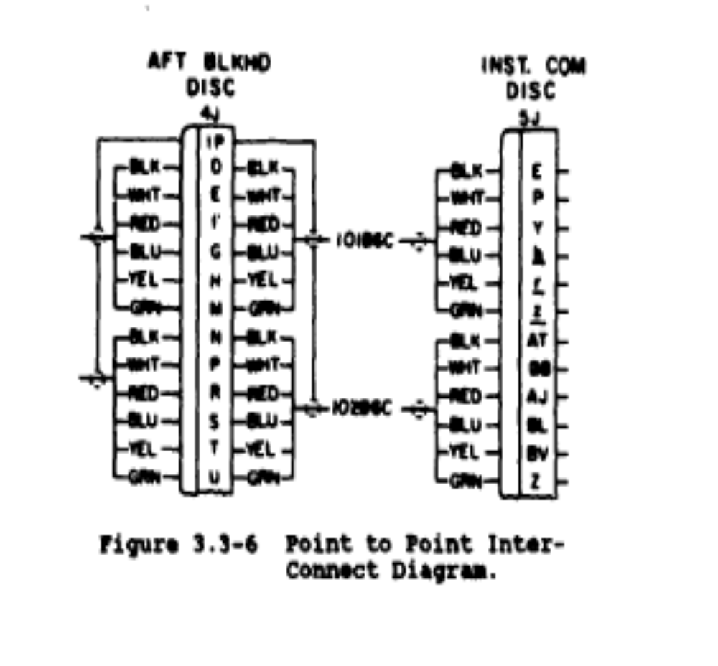
From AGARDOGRAPH Vol 160 Number 13 “Practical Aspects of Aircraft
Instrumentation Installation”
Notes:
A point to point diagram shows a single harness (or group of wires) between two points showing both sides of both ends of the wire harness. Typically a connector with pins is referred to as a P connector and a connector with sockets is referred to as a J connector. Mating P and J halves usually have the same number (i.e. P256 mates to J256).

Slide 23
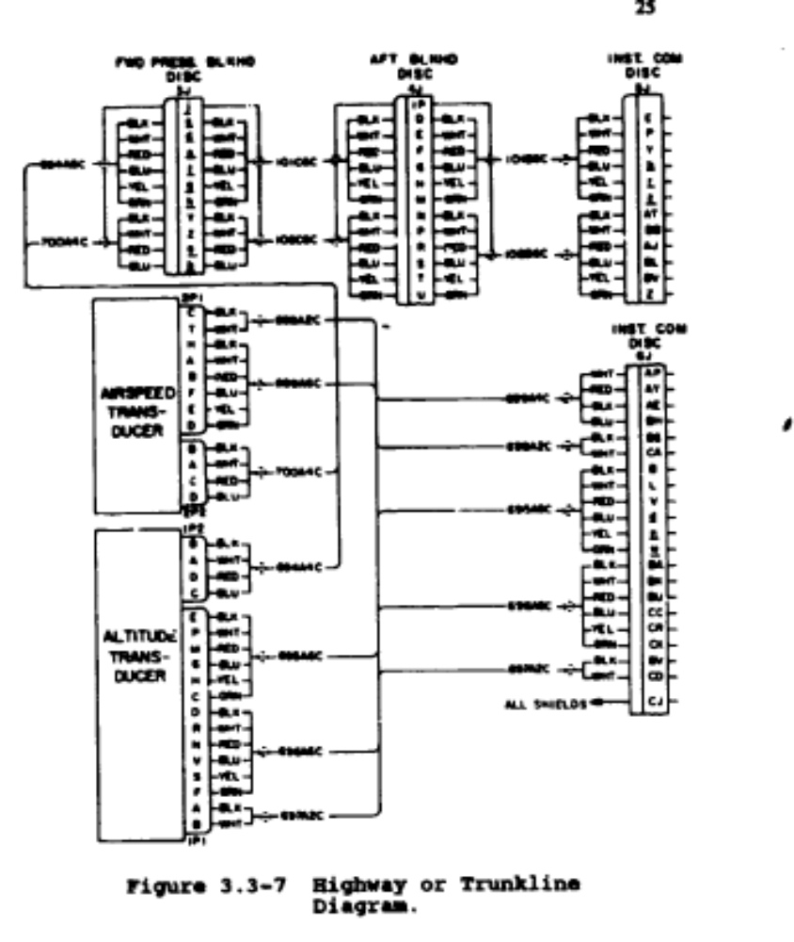
From AGARDOGRAPH Vol 160 Number 13 “Practical Aspects of Aircraft
Instrumentation Installation”
Notes:
This is a highway or trunkline diagram. This type of diagram incorporates the fact that single harness may contain multiple branches allowing multiple locations to be connected to a single location. This is very common when for example, power and data signals from a componenta re all wired into a single connector. In this case data and power have to branch to different sources or destinations. The upper part of this diagram contains a bulkhead connection. This type of connection is normally used when feeding through a structure such as a wall.

Slide 24
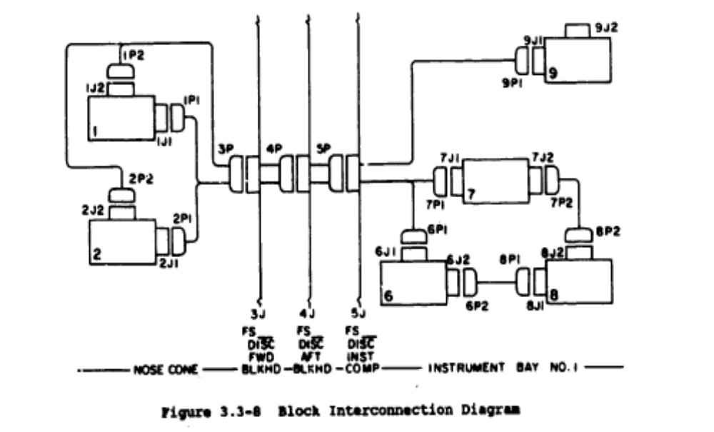
From AGARDOGRAPH Vol 160 Number 13 “Practical Aspects of Aircraft
Instrumentation Installation”
Notes:
This is a block interconnection diagram. This shows the general arrangement of boxes and connections. Note the presence of three bulkhead connections in the middle of this diagram.

Slide 25
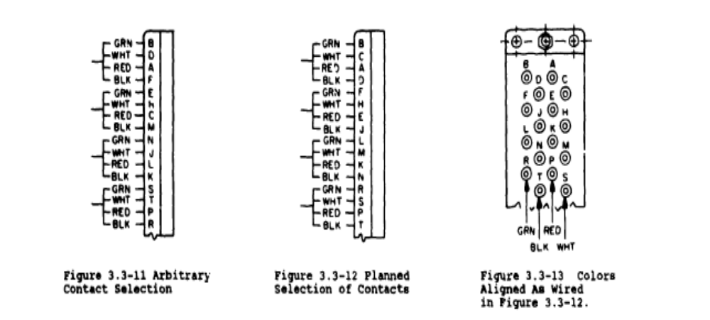
By careful selecting on contacts, you can make connectors easier to inspect for errors
Notes:
In instrumentation it sis common to have 4 connections – Power, Ground, Signal + and Signal -. These are usually assigned the colors Red, Black, White and Green. By carefully arranging contacts in a connector, you can make it easy to visually asses the connector for errors in wiring.

Slide 26
Connector hazards
Sparking on connection/disconnection
  Control with explosion proof connections
Incorrect mating of pins-sockets can energize or ground circuits inadvertently
  Control by insert orientation or keying

Slide 27
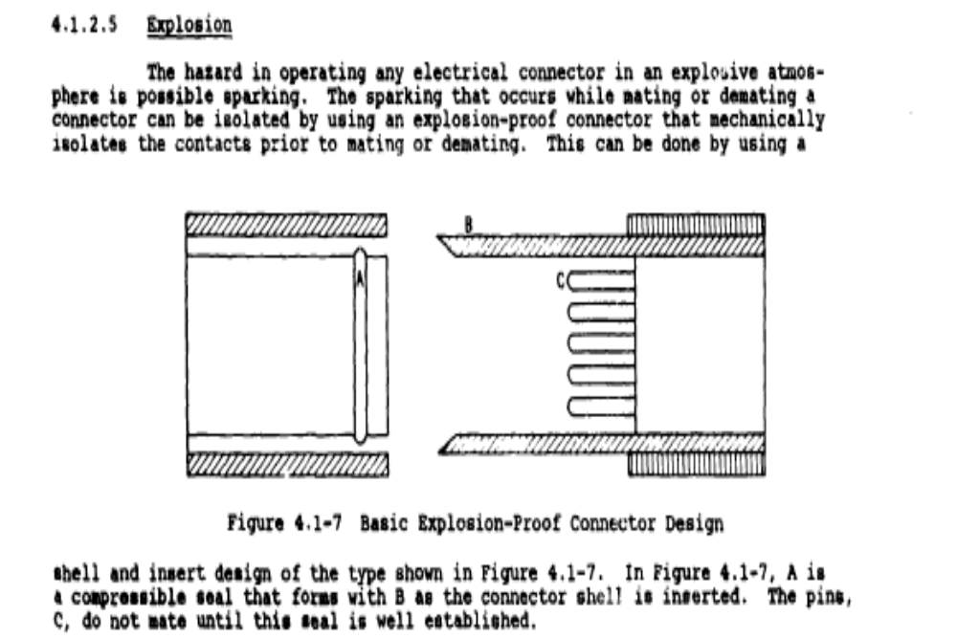
From AGARDOGRAPH Vol 160 Number 13 “Practical Aspects of Aircraft
Instrumentation Installation”

Slide 28
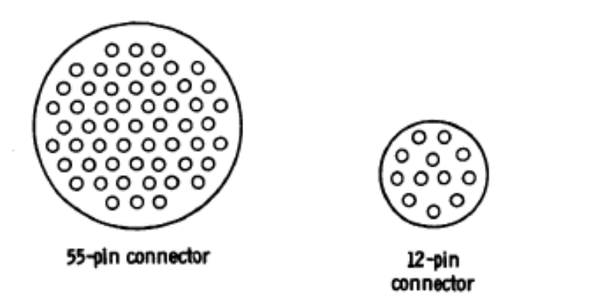
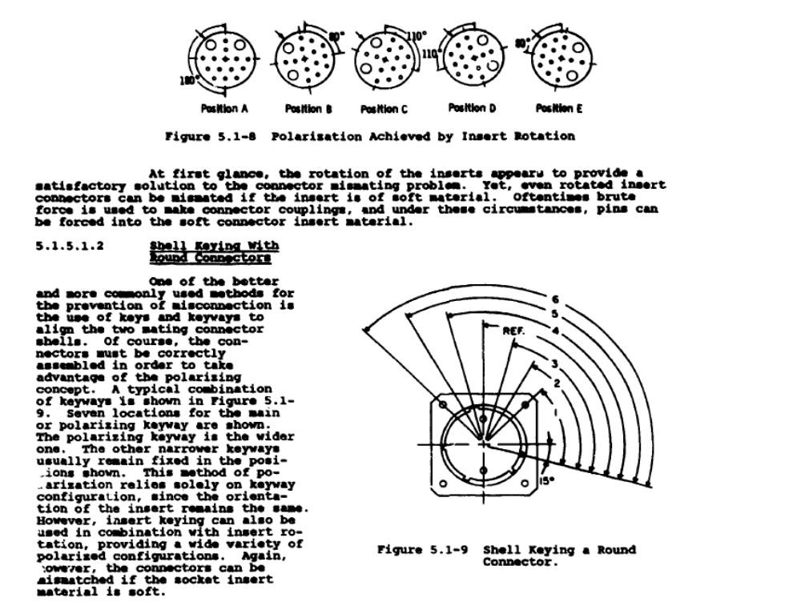
From AGARDOGRAPH Vol 160 Number 13 “Practical Aspects of Aircraft
Instrumentation Installation”
Keying of connectors

Slide 29
Good Pin-Socket design techniques
Keep power and ground pins separated by at least one pin
  Adjacent pins may be bent over and touch
Keep redundant functions on separate connectors
  Redundant functions not defeated by a disconnected or loose connector
In general, use a socket on the side of the connector supplying power
  In case the power is energized when the connection is made, use of the socket prevents a “hot” pin from being exposed when the connector is demated
    Hot sockets generally cannot energize anything unless a wire or pin is inserted in the socket
  Good to use “scoop-proof” connectors – both pins and sockets are recessed so that it is harder to short out a cable that is inadvertently energized while disconnected
Keep high power/low frequency signals separated from low power/higher frequency signals
  Avoids electromagnetic coupling

Slide 30
Many Data Interfaces are Digital interfaces
Digital interfaces communicate by exchanging information through one of two signal levels
These are called binary digits or bits
There are many different ways to communicate information digitally

Slide 31
Parallel vs Serial
Serial
  Use one wire (or a pair of wires) to communicate many bits of information by changing the information on the wires in time
  Not all information available at all times
  Must have a clocking and synchronization mechanism
  Most widely used mechanism
Parallel
  use N wires to communicate N bits of information
  All information available all the time
  Used mostly for high speed communication for small amounts of information

Slide 32
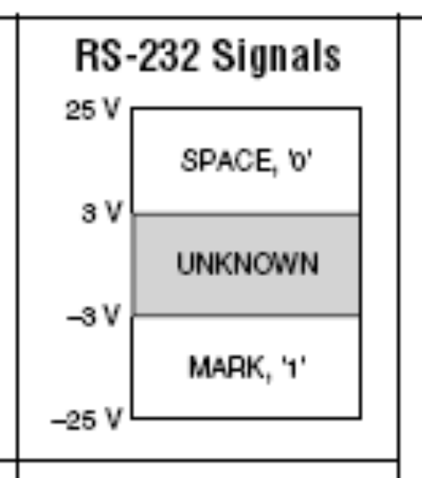
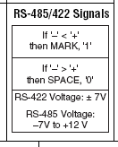
Serial Digital Interface Standards
485/422 use two lines, a + and a -
Many other digital interface standards exist
  USB
  Firewire
  Ethernet
  SCSI
Notes:
These are the voltage levels assigned to two common interface standards.

Slide 33
Ways of looking at a binary number
As a binary string – a base 2 representation
  Example 0 0 0 1 0 1 0 1 = decimal 21
As octal – in 3 bit segments – a base 8 representation
  Example 0 0 0 1 0 1 0 1 is clustered as
  0 0 0 0 1 0 1 0 1 = octal 025
  Octal 0 2 5 = 8*2 + 5*1 = 21 decimal
As hexadecimal – in 4 bit segments – a base 16 representation
  Example 0 0 0 1 0 1 0 1 is clustered as
  0 0 0 1 0 1 0 1 = hexadecimal 15
  Hexadecimal 15 = 1*16 + 5 = 21
  Note in Hex, we can have digits representing 10-15, so we use A-F
  So 26 in base 10 is 1A in Hexadecimal (16 + 10)

Slide 34
Binary Coded Decimal and Gray Code
BCD – Binary Coded Decimal is an old style representation still used in some electronics where 4 bits are used to describe every decimal digit
  Example Decimal 21 would be 0010 0001
  Convenient in simple instruments because math can be implemented without a complicated processor because the digits are already separated
  I’ve seen it a lot in avionics (airplane electronics) like navigation receivers
  It is still common today in electronics that have simple alphanumeric displays but it is fading out of existence
Gray Code – is a mapping of decimal numbers to a binary representation where the only difference between two adjacent numbers is a single bit
  Originally designed to prevent ambiguity in systems with electromechanical switches
    Because switches don’t necessarily change at the same time, transitions of more than one switch could result in spurious outputs
    Example :
    In a straight binary code a transition from 7 (0111) to 8 (1000) involves 4 bits switching. If the msb was slower than the rest, the outputs could look like 0 for a short period of time
    In a gray code, only one bit switches at a time when incrementing or decrementing
  Useful in error correction schemes in modern telecommunications

Slide 35
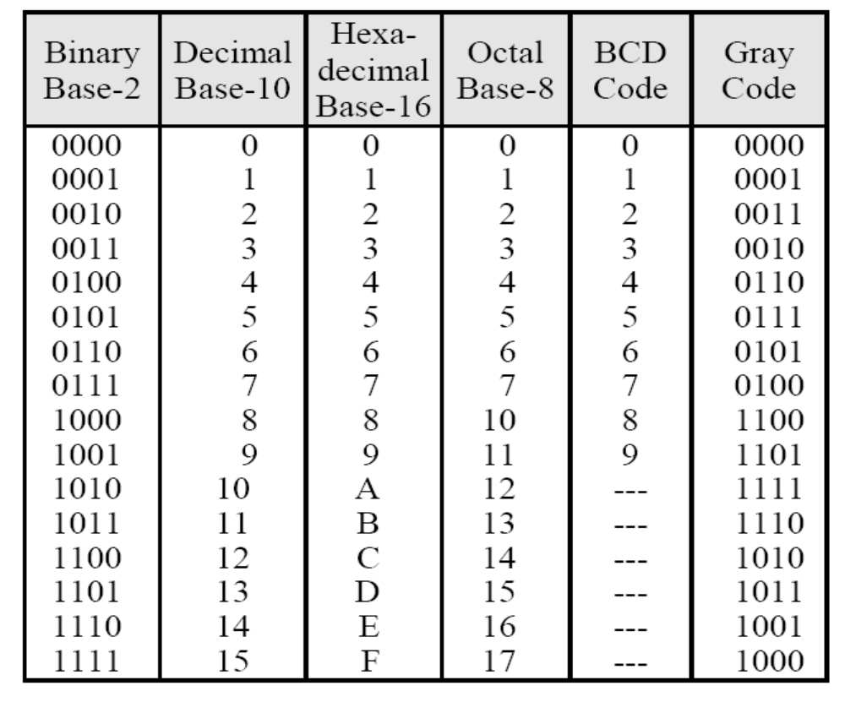
Binary Codes
From NCEES Fundamentals of Engineering Supplied Reference Handbook available at www.ncees.org

Slide 36
Unsigned and Signed Binary Integers
Unsigned Integer
  Binary representation right justified in the word
Signed Integer – Two’s Complement
  Define magnitude as if unsigned
  Perform bitwise complement
    Every 1 becomes a 0, Every 0 becomes a 1
  Then add 1
  Note that the MSB for all negative numbers is always 1 and is also referred to as the sign bit. Also note that the maximum magnitude of the negative number is always one half that of the maximum positive number

Slide 37
Two’s Complement Example
Example
Decimal 21 = 0001 0101
Bitwise complement = 1110 1010
Add 1 + 1
----------------
1110 1011 = -21
Check for consistency add 21 and -21 – it should be 0
0001 0101
+ 1110 1011
-------------
0000 0000
See Number Formats.VI for examples

Slide 38
Character Codes
It would be very difficult to interact with computing machinery if we limited ourselves to exchanging numbers
By exchanging characters we can significantly improve our interaction
Two common character code systems exist
  American Standard Code For Information Interchange (ASCII) – the most common – a 7 bit code
  Extended Binary Coded Decimal Interchange Code (EBCDIC) - only used on IBM mainframes – a 8 bit code
These systems include the normal alphabet, punctuation, simple mathematical symbols and control codes

Slide 39

ASCII Character Codes

Slide 40
Any Questions ?

